Slide 1

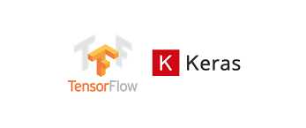
TensorFlow Foundation

Slide 2
What is TensorFlow
TensorFlow is a free and open-source software library for machine learning and artificial intelligence. It was developed by Google and released in 2015.
TensorFlow allows users to build and deploy machine learning models using a variety of techniques, including deep learning, neural networks, and gradient-based optimization. It provides various tools and libraries for implementing and training machine learning models and for serving and deploying those models in production environments.
The core structure of TensorFlow consists of a computation graph, in which nodes represent mathematical operations and edges represent the flow of data between nodes. TensorFlow allows users to define and execute computation graphs in Python or C++, as well as to use pre-trained models and load data from various sources.

Slide 3
What is Tensorflow
TensorFlow also provides a variety of tools and libraries
for tasks such as data preprocessing, visualization, and
evaluation of machine learning models. These tools
include the TensorFlow Data API, TensorFlow Estimators,
and TensorFlow Serving, among others.
Overall, TensorFlow is a powerful and flexible platform
for building and deploying machine learning models at
scale. It is widely used in research and industry and has a large and active community of users and developers.

Slide 4
TensorFlow Modules
The TensorFlow library includes a range of modules that can be used to perform various tasks in machine learning and deep learning. Some examples of TensorFlow modules include:
tf.keras: This module provides high-level APIs for building and training machine learning models using the Keras API.
tf.data: This module provides tools for building efficient data pipelines for feeding data to machine learning models. few examples of how you can use ‘tf.data’
tf.data.TextLineDataset: read lines of text from one or more files
tf.data.TFRecordDataset: read binary records written using TensorFlow’s ‘tf.io.TFRecord’ format
Preprocessing data: You can use the ‘map’,’ batch’, and ‘shuffle’ methods to apply transformations to the data, such as parsing, tokenization, and batching.

Slide 5
TensorFlow Modules
tf.estimator: This module provides a high-level API for training and evaluating machine learning models. Estimators are built on top of the lower-level TensorFlow API and provide a higher-level interface for working with TensorFlow models so you can focus on the overall design and strategy of your model.
tf.layers: This module provides a set of predefined neural network layers that can be used to build machine learning models.
Dense layers: Also known as fully-connected layers, dense layers connect all of the inputs in the layer to all of the outputs in the layer.
Convolutional layers: These layers are used for processing data with a grid-like topology, such as images. They apply a set of filters to the input data to extract features.
Pooling layers: Pooling layers subsample the input data and reduce its dimensionality. This can help to reduce overfitting and improve the performance of the model.

Slide 6
TensorFlow Modules
Recurrent layers: These layers are used for processing sequential data, such as time series or natural language. They maintain a state that is updated at each timestep and allow the model to consider the context of previous timesteps when processing the current timestep.
Dropout layers: Dropout is a regularization technique that randomly sets a fraction of the inputs to zero during training. Dropout layers implement this technique in TensorFlow models.
Batch normalization layers: Batch normalization is a technique that normalizes the inputs within a batch to have zero mean and unit variance. This can help to improve the performance and stability of the model.
Flatten layers: These layers flatten multi-dimensional inputs into vectors.
Reshape layers: These layers reshape the input tensors into a different shape.

Slide 7
TensorFlow Modules
tf.losses: This module provides a set of predefined loss functions that can be used to train machine learning models. Some of the losses are :
Mean squared error (MSE): This loss function is commonly used for regression tasks. It computes the mean squared difference between the predicted and ground truth values.
Cross-entropy loss: This loss function is commonly used for classification tasks. It measures the difference between the predicted class probabilities and the ground truth class labels.
Hinge loss: This loss function is used for binary classification tasks and is often used with support vector machines (SVMs). It computes the loss based on the difference between the predicted class probabilities and the ground truth labels.
Cosine similarity loss: This loss function is used for measuring the similarity between two vectors. It is often used for tasks such as word embedding and speaker verification.
tf.losses.compute_weighted_loss: Used to define a custom loss function that computes the loss and a weight for each element in the loss

Slide 8
TensorFlow Modules
tf.metrics: This module provides a set of predefined metrics for evaluating the performance of machine learning models. Some common metrics include:
Accuracy: This metric calculates the fraction of predictions that are correct. It is often used for classification tasks.
Precision: This metric measures the fraction of positive predictions that are correct. It is often used in conjunction with recall.
Recall This metric measures the fraction of actual positive instances that are correctly predicted as positive. It is often used in conjunction with precision.
AUC: This metric measures the area under the curve of a receiver operating characteristic (ROC) curve. It is often used for binary classification tasks.
F1 score: This metric is the harmonic mean of precision and recall. It is a good metric to use when you want to balance precision and recall.

Slide 9
TensorFlow Modules
There are many other TensorFlow modules that can be used for various tasks in machine learning and deep learning. You can find more information about these modules in the TensorFlow documentation.

Slide 10
Keras
Keras API was built as a Theano wrapper by Francois Chollet.
Theano was the most popular deep learning library in python when deep learning was becoming popular.
Since Theano was complicated, that’s why Keras was so useful!
As deep learning became popular, Keras was expanded to wrap more libraries(TensorFlow, CNTK, etc).
The inventor of Keras (Francois Chollet) was hired by google to do more research on Deep Learning, hence the choice of making the Keras API front and center is obvious.

Slide 11
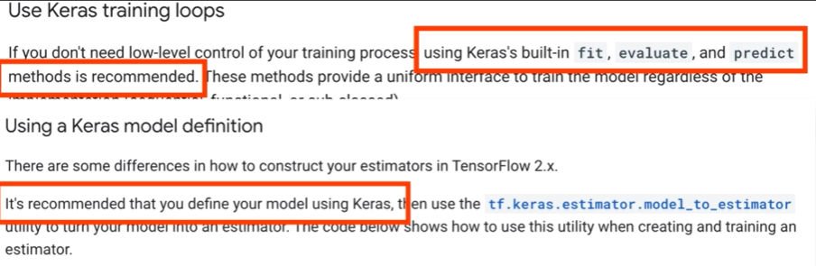
Why Keras ?
In Software Engineering, We want things to be easy.
Google advised how to use TF2 in many presentations given in the summer of 2019 to promote TensorFlow 2, and has stated the same thing

Slide 12
Keras Modules
Keras provides a number of modules that you can use to build and train deep learning models. Some of the main modules in Keras include:
Layers: This module provides a variety of pre-built layers that you can use to build your model.
Dense layers: Also known as fully-connected layers, dense layers connect all of the inputs in the layer to all of the outputs in the layer.
Convolutional layers: These layers are used for processing data with a grid-like topology, such as images. They apply a set of filters to the input data to extract features.
Pooling layers: Pooling layers subsample the input data and reduce its dimensionality. This can help to reduce overfitting and improve the performance of the model.

Slide 13
Keras Modules
Recurrent layers: These layers are used for processing sequential data, such as time series or natural language. They maintain a state that is updated at each timestep and allow the model to consider the context of previous timesteps when processing the current timestep
Dropout layer: This layer randomly sets a fraction of input units to 0 at each update during training time, which helps to prevent overfitting
Models: This module provides functions for creating and compiling deep learning models. You can use it to define the architecture of your model, specify the loss function and optimizer that you want to use, and compile the model for training.
Preprocessing: This module provides functions for preprocessing data that you can use before feeding it into your model. This can include tasks such as scaling data, encoding categorical variables, and splitting data into training and test sets.

Slide 14
Keras Modules
Utils: This module provides a variety of utility functions that you can use when working with deep learning models. This can include functions for saving and loading models, visualizing results, and more
Activations: module provides a range of functions that can be used as activation functions in a neural network such as relu, sigmoid, tanh, softmax etc

Slide 15
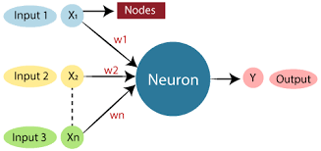
What is a Neuron?
In artificial neural networks (ANNs), a neuron is a computational unit that takes in inputs, processes them, and produces an output. It is inspired by the structure and function of neurons in the human brain.
Each neuron receives input from other neurons or external sources through a set of weighted connections. The weights of these connections correspond to the strength of the influence that each input has on the neuron's output. The neuron processes the inputs by applying an activation function, which determines the output of the neuron based on the inputs and their weights. The output of the neuron
is then passed on to other neurons or used as the
final output of the neural network.

Slide 16
O/P of a Neuron
The output from a neuron in a neural network is the result of applying the activation function to the weighted sum of the inputs to the neuron.
For example, if a neuron has three inputs, x1, x2, and x3, and corresponding weights w1, w2, and w3, the weighted sum of the inputs would be calculated as follows:
weighted_sum = x1 * w1 + x2 * w2 + x3 * w3
The activation function would then be applied to the weighted sum to produce the output of the neuron

Slide 17
Activation Functions
Sigmoid: The sigmoid activation function maps any input to a value between 0 and 1. It is often used in the output layer of a binary classification model, where the output is interpreted as the probability that the input belongs to a certain class.
Tanh: The tanh activation function, like the sigmoid function, maps any input to a value between -1 and 1. It is similar to the sigmoid function, but it is centered around 0, which can make it easier to train deep neural networks.
ReLU: The rectified linear unit (ReLU) activation function returns the input if it is positive, and returns 0 if it is negative. This function is widely used because it is simple to compute and has been shown to work well in practice.
Leaky ReLU: The leaky ReLU is an extension of the ReLU activation function that allows for a small gradient when the input is negative. This can help improve the performance of the model on certain tasks.

Slide 18
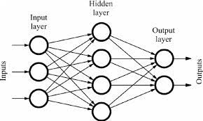
What is ANN
Artificial neural networks (ANNs) are a type of machine learning algorithm modeled after the structure and function of the human brain. They are composed of interconnected units called "neurons," which process and transmit information.
In this lecture, We are going to specifically discuss a special kind of artificial neural network called Feed Forward Neural Network.

Slide 19
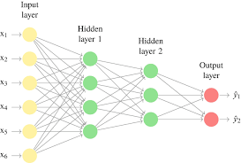
Repeating a Single Neuron
Left side is input and the right side is output
In the real brain, the connection can be a “Criss Cross”
A later neuron may connect back to an earlier neuron to create a recurrent connection.
As the signal travels only from left to right, we call this kind of networks as “Feedforward” Neural network
Each of these neurons may be
calculating different features
E.g. Let’s suppose input is a face,
then one neuron looks for the presence
of eyes whereas other looks for the
presence of nose.

Slide 20
Model training
In a feedforward neural network, the learning process involves adjusting the weights and biases of the neurons in the network in order to minimize the error.
Backpropagation is an algorithm used to train artificial neural networks (ANNs).
The ANN makes a prediction based on the current weights and then compares the predicted output to the true output. The difference between predicted and true output is computed to compute an error value.
The backpropagation algorithm then adjusts the weights in the network to reduce this error.

